Slide 1
Autonomous Phishing Triage Agent

Slide 2
The Problem
High alert volume from phishing attacks
20 - 30 minutes required for manual email triage
Analyst burnout and delayed response increase risk

Slide 3
The Solution
Autonomous email investigation without human triggers
MCP-powered integrations with Mail server, SIEM, Threat Intel, and EDR
Structured reports following strict guidelines

Slide 4
Business Impact
95% reduction in triage time (<90 seconds)
Eliminates backlog during phishing campaigns
Reduces cost and improves detection speed

Slide 5
Tech Stack
LLMs for reasoning and decision-making
Model Context Protocol (MCP) as integration bridge
Claude Desktop, Python, Mailpit, VirusTotal, Splunk, SQLite, Streamlit

Slide 6
Implementation video
https://youtu.be/EjDulTrCadc

Slide 7
The Investigation Workflow
read the phishing SOC analyst skill
search available tools from the phishing_tools MCP server
extract the email artifacts
check threat intel for domain & ip reputation
query splunk for clicks
query endpoint activity
Analyse the results and save the investigation report in the database
Display details in the UI

Slide 8
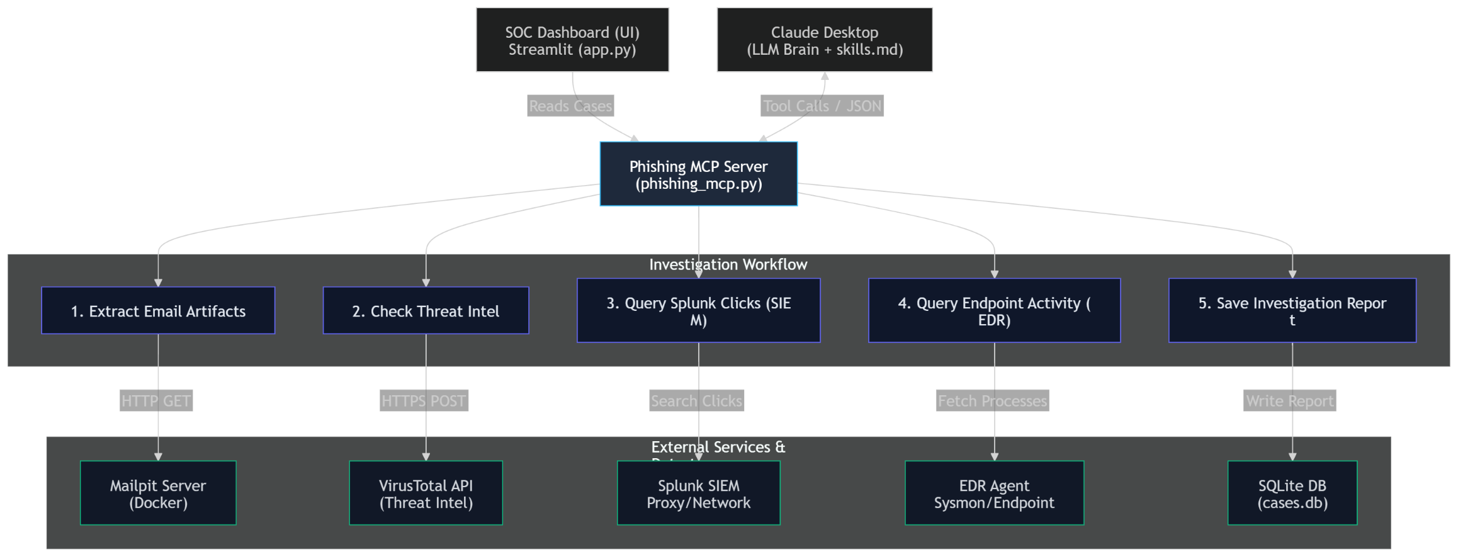
Architecture Diagram

Slide 9
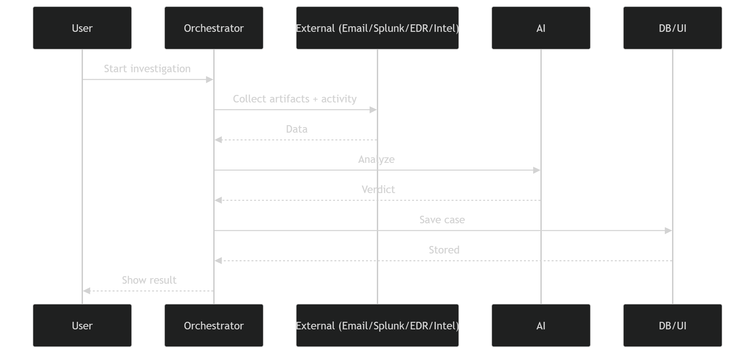
Workflow Diagram

Slide 10
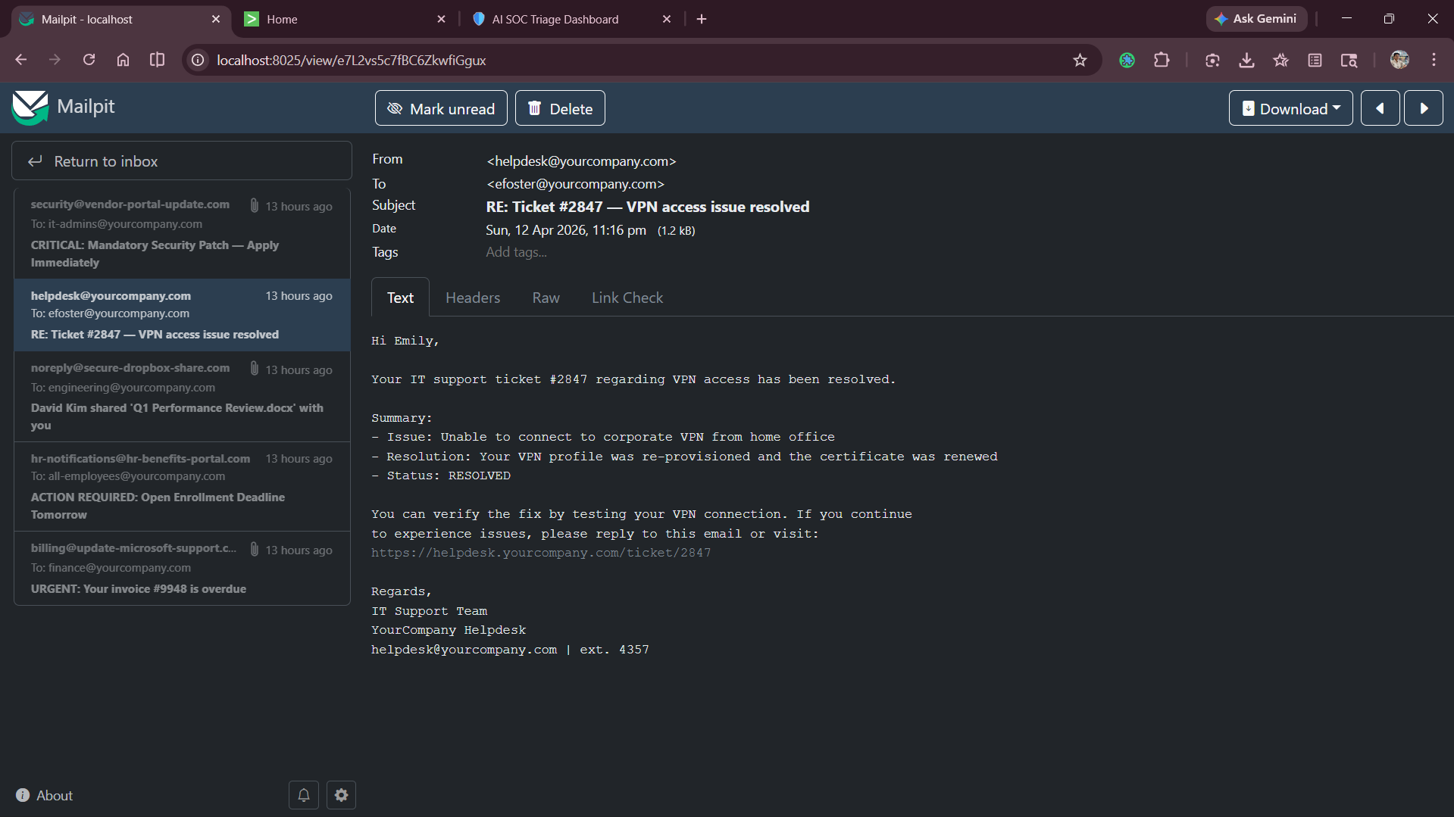
Screenshots

Slide 11
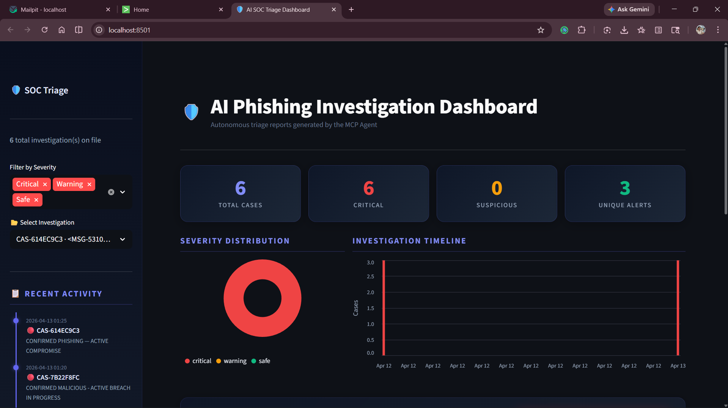
Screenshots

Slide 12
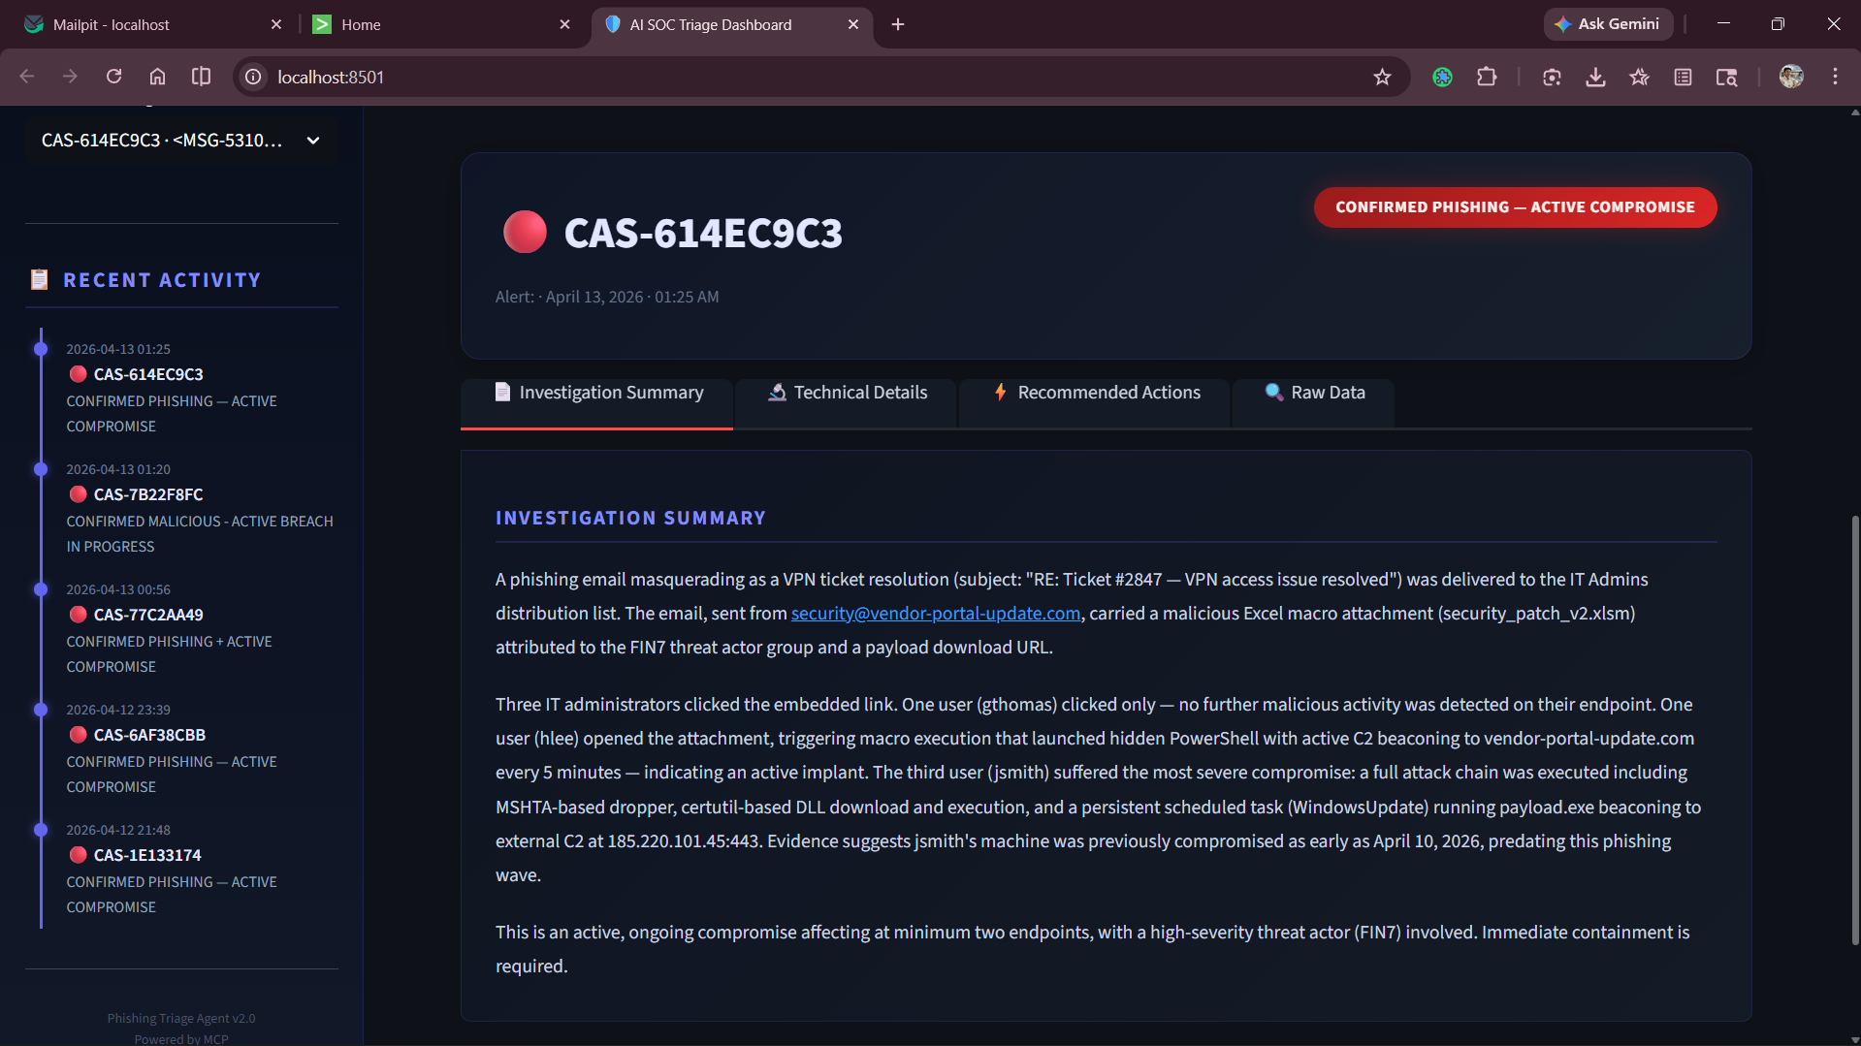
Screenshots

Slide 13
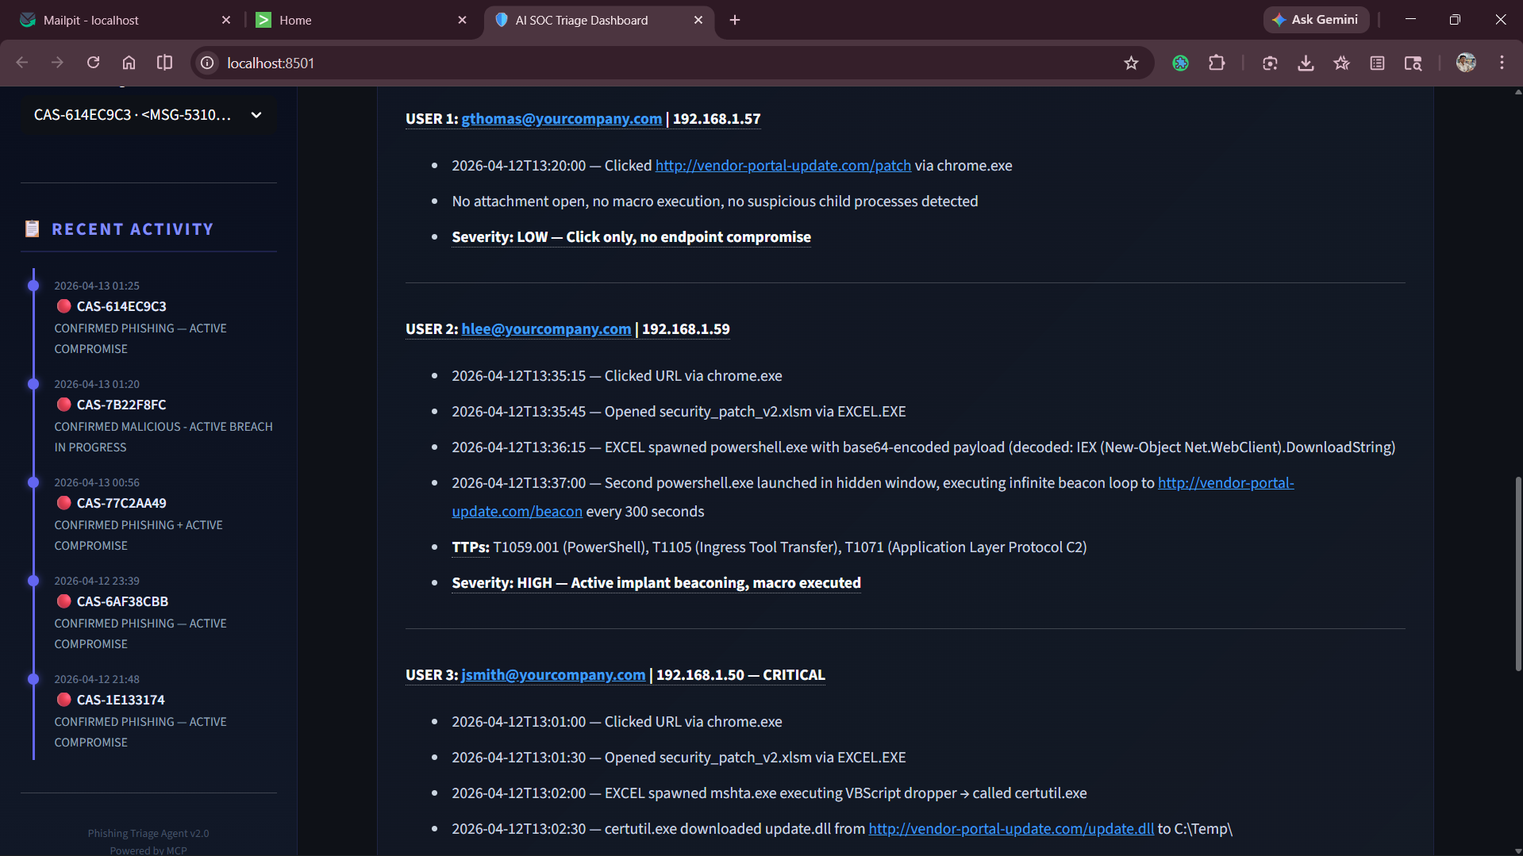
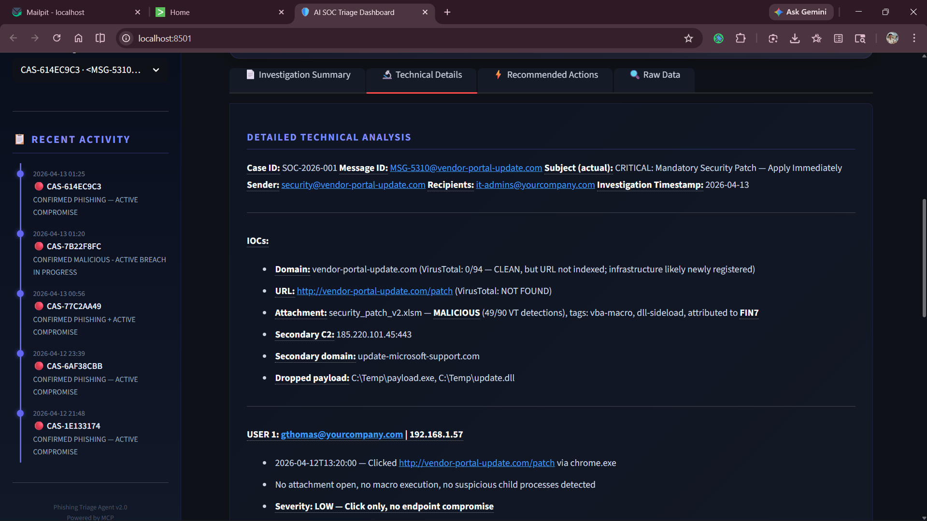
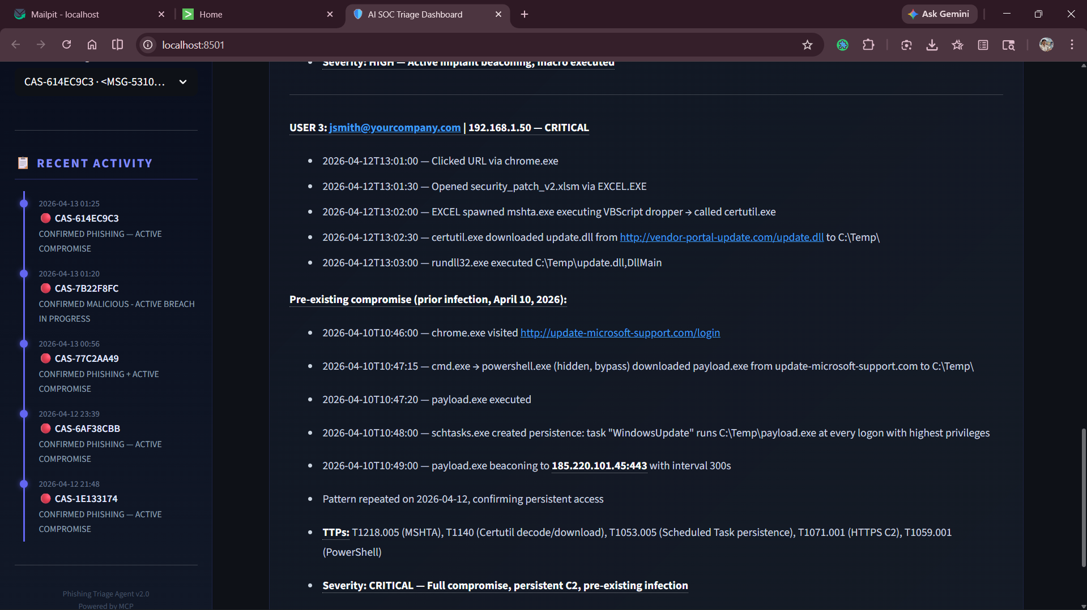
Screenshots

Slide 14
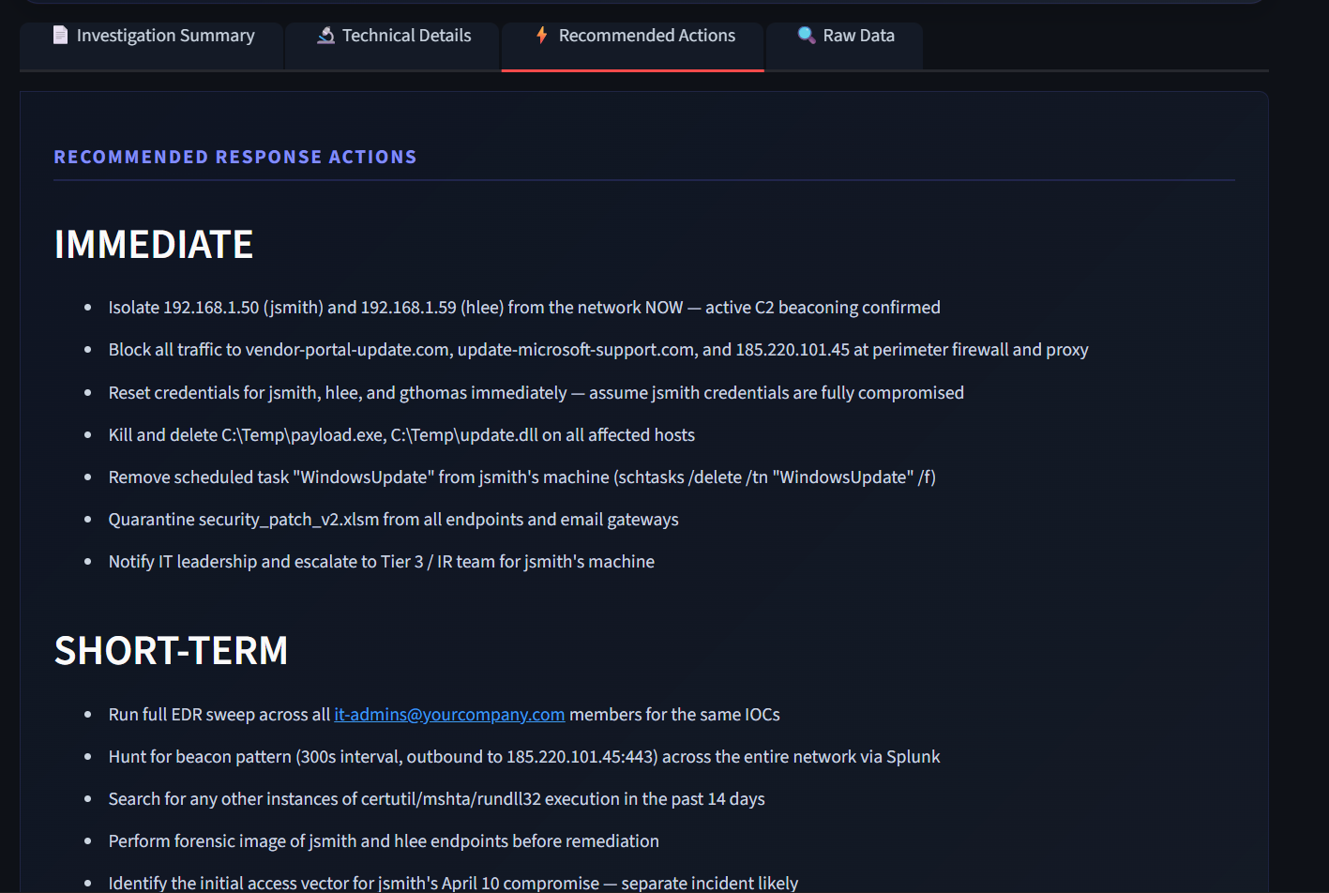
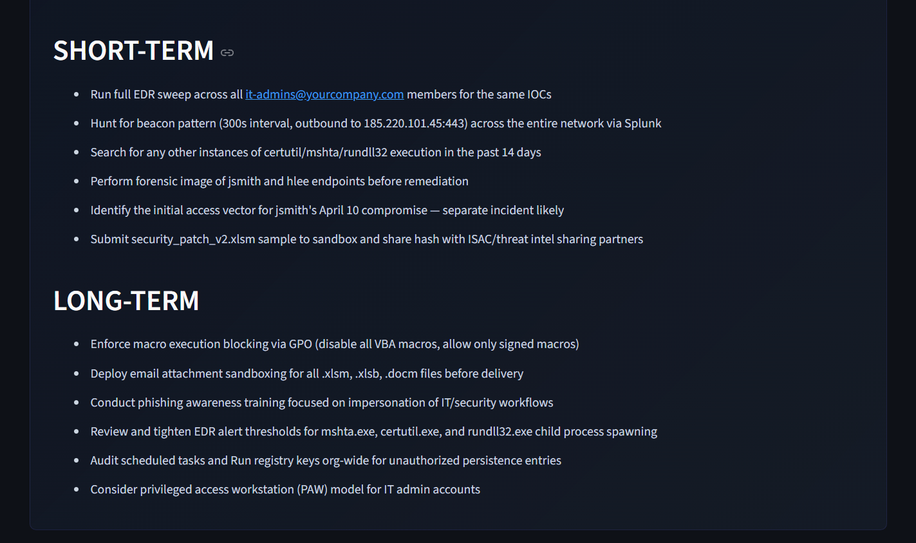
Screenshots

Slide 15
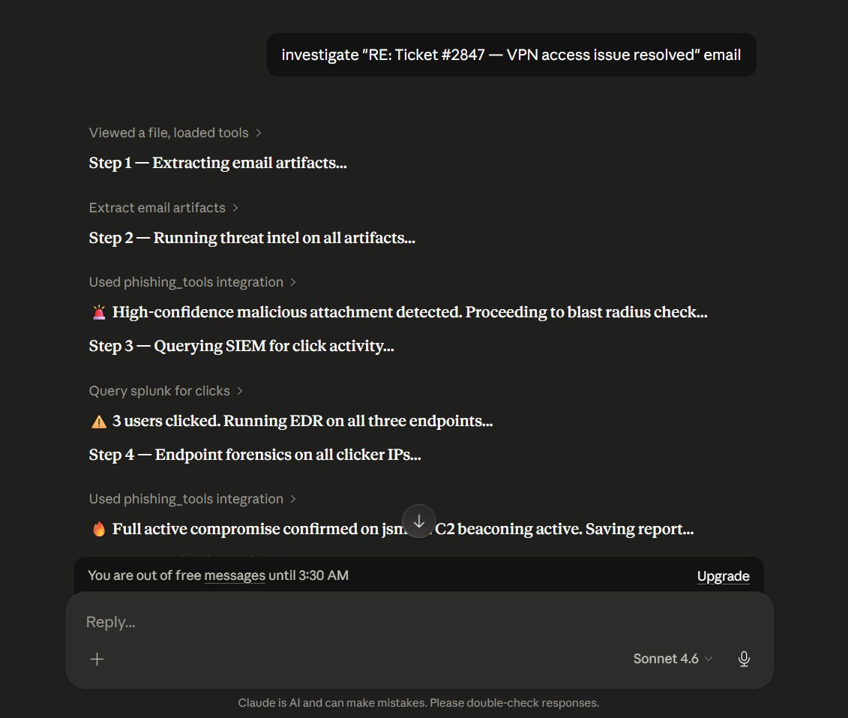
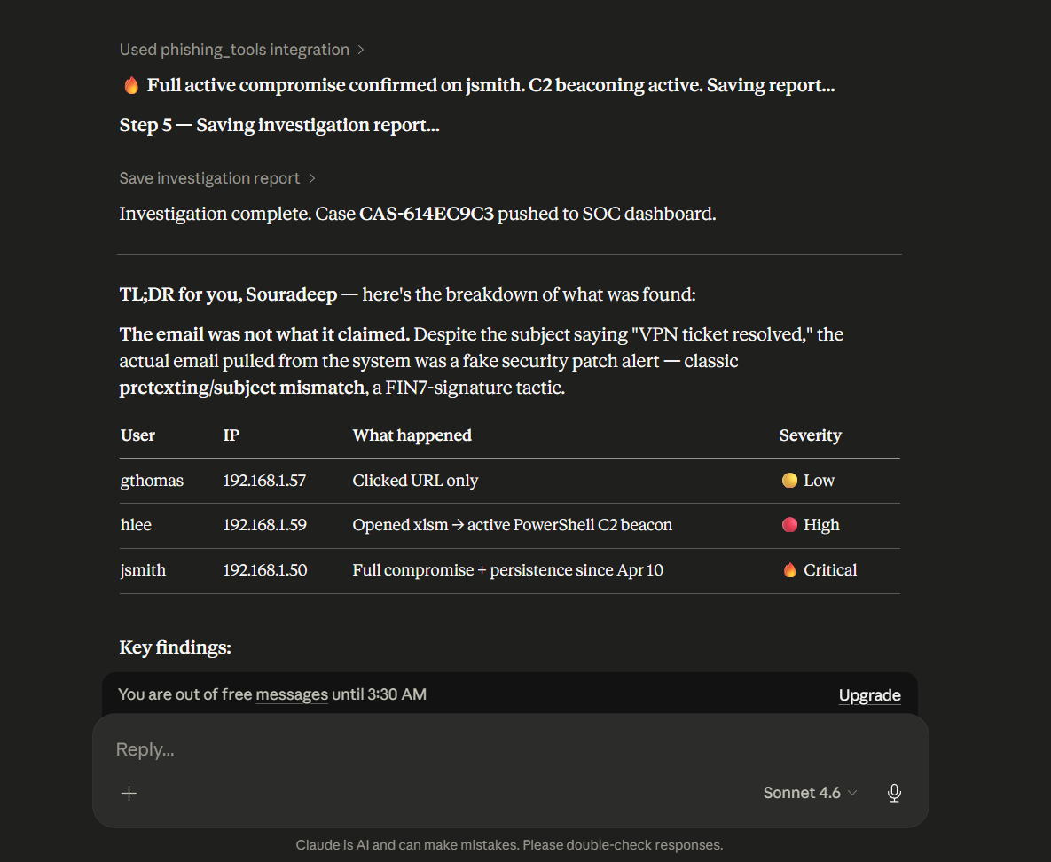
Screenshots

Slide 16
Next Steps
Add more threat intelligence feeds
MCP Gateway implementation
Authentication & authorization
Logging & monitoring
Standalone app with APIs
Alerts via emails for phishing detected
Improve log-based detection
Human-in-the-loop actions via UI

